Slide 1
ESW Project
Indoor air pollution

Slide 2
Team Details(Team 26)
P. Seetha Raghavendra 2019101074
D. Praneeth 2019101002
M. Revanth 2019101052
T. Sai Sathwik 2019101045
Soma Datta reddy 2019111018

Slide 3
Briefing about the project
The air of good quality is one of the essential things for humans in conducting their day-to-day activities.
Daily activities are often conducted indoor by majorities.
The outbreak of Covid 19 made indoor air quality even more important since the pollutants trapped inside may facilitate the transmission of the virus.

Slide 4
Briefing about the project
In this regard, we want to make an indoor air quality monitoring system based on the Internet of Things sensors, providing a platform to measure numerous indoor contaminants, which also shows air quality.
If time permits and if we found a good solution, we want to make the system predict air quality for future instances.

Slide 5
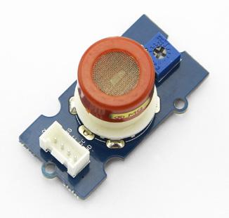
Sensors used in this project
Grove - Gas Sensor(MQ9)
This sensor is used to detect the gas leaks such as CO, CH4.

Slide 6
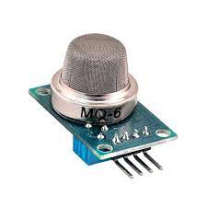
Sensors used in this project
Mq6 gas sensor
This sensor is used to detect the gas leaks such as Lpg.

Slide 7
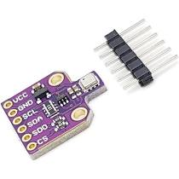
Sensors used in this project
Bme 680 sensor
This sensor is used to detect the gas, humidity, temperature, and pressure.

Slide 8
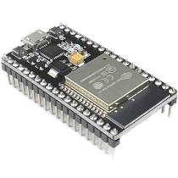
Other project components.
Esp32 microcontroller
To transfer sensor data to the cloud and monitor it in the apps.

Slide 9
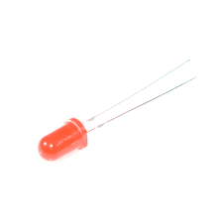
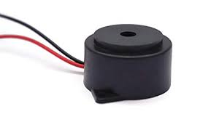
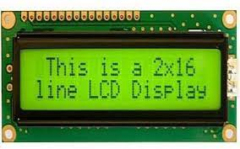
Other project components.(basic)
Buzzer to alert if the air quality is poor.
Led Bulbs.
Bread board.
Display board.
Battery.

Slide 10
Schedule
Sensor connection(Phase-1)
September 7
connecting sensors and briefly testing the model.

Slide 11
Schedule
Data analysis(Phase-2)
September 15
comparing the data of the sensors in different environments. Understating the sensors and its drawbacks if any to modify and use different sensors.

Slide 12
Schedule
Bread board deployment(Phase-3)
September 23
Attaching all sensors to the bread board.

Slide 13
Schedule
One M2M(Phase-4)
October 1
Pushing the sensor data and analysis to one M2M server.
Basic documentation of our results

Slide 14
Schedule
Buffer
October 7
If there are any backlogs of documentation and any other part we will use this time to complete it.

Slide 15
Schedule
Thingspeak integration(Phase-5)
October 17
Coding for the thingspeak integration part.

Slide 16
Schedule
Web app interface(Phase-6)
October 23
Online web app interface to monitor the values.

Slide 17
Schedule
Finalising the project model(Phase-7)
November 1
Soldering the model with the sensors and finilizing it. Checking for the errors and fixing the model.

Slide 18
Schedule
Submission (Phase-8)
November 9
One last check for the model and documentation.

Slide 19

Thank you

